Slide 1

Hamiltonian -Cycle
Prepared By : 1705019 1705026 1705029 1705030 1705087
01

Slide 2






Team Members
Elaborate on what you want to discuss.
Nakshi
Rakin
Dristy
Joy
Fahmid
1705019
1705026
1705029
1705030
1705087

Slide 3

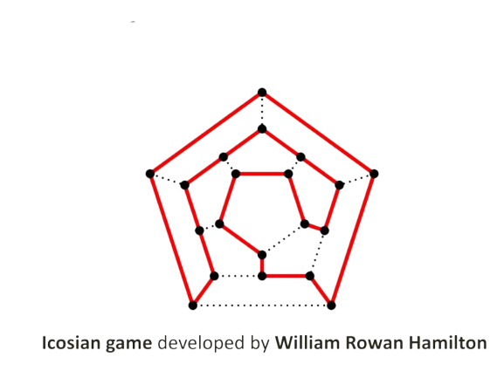
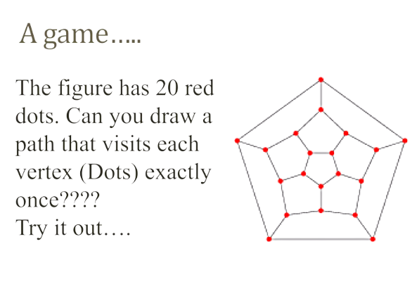
History

Slide 4
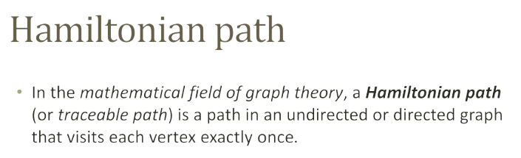

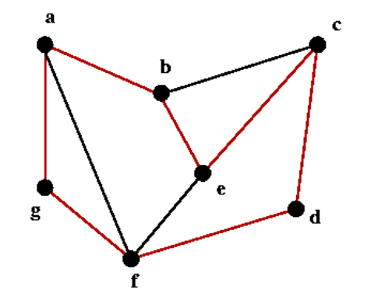
Red Edges are in path

Slide 5
Hamiltonian Definations
A Hamiltonian path or traceable path is a path that visits each vertex exactly once.
A graph that contains a Hamiltonian path is called a traceable graph.
A graph is Hamiltonian-connected if for every pair of vertices there is a Hamiltonian path between the two vertices.
A Hamiltonian cycle, Hamiltonian circuit, vertex tour or graph cycle is a cycle that visits each vertex exactly once (except for the vertex that is both the start and end, which is visited twice).
A graph that contains a Hamiltonian cycle is called a Hamiltonian graph.

Slide 6
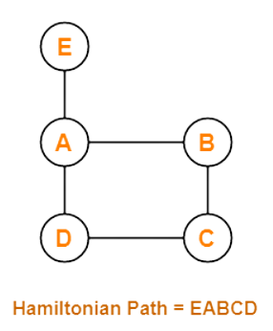
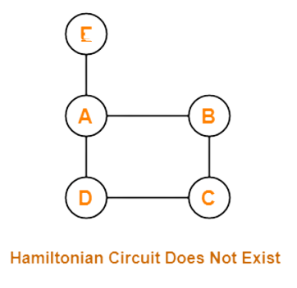

Difference

Slide 7
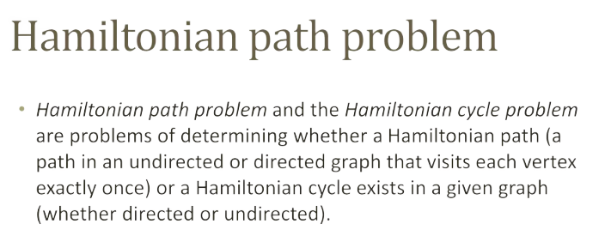
Hamiltonian problem is NP complete
- Well know Np complete problem where we can not find linear time complexity algorithm to fin Hamiltonian cycle or path in the graph

Slide 8

Some Algorithm for HC
Brute Force Algorithm
Backtrack Algorithm
Heuristic Algorithm
Ham heuristic algorithm
Best Edge Algorithm
Nearest Neighbor Algorithm
Repetitive Nearest Neighbor Algorithm

Slide 9
Applications
Used in fault random geometric network
It has real applications in such diverse fields as computer graphics, electronic circuit design, mapping genomes, and operations research
In a Networks , if a Hamiltonian Cycle exist then fault toelrance is better .

Slide 10
Thank you!
I’m so grateful for your patience

